Slide 1
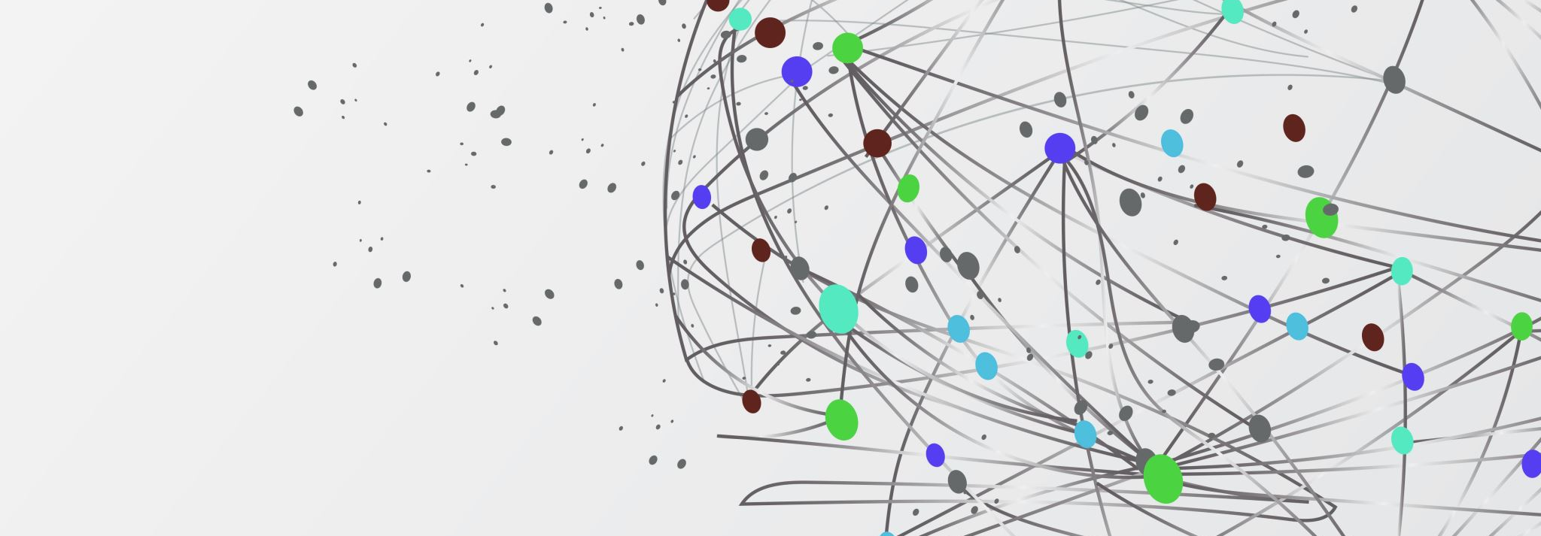
Vodafone Customer Service Analysis
A unified data-warehouse solution to eliminate silos
Analysis by Group 5: Abhinandan Singhi Deep Patel Vipra Patel Fangfang Tang Pratik Chikhali

Slide 2
THE CHALLENGE
3 isolated systems: Prepaid | Postpaid | Broadband
51% duplicate records (57 → 28 unique users)
Billing errors: 8 uncredited recharges ($270)
No visibility into multi-service customers

Slide 3
OUR VISION
Create a unified, analytics-ready data warehouse
100% accurate customer identification using license numbers
Real-time dashboards for executives and analysts
Cloud-first, scalable, and privacy-compliant design

Slide 4
SOLUTION ARCHITECTURE
Source Layer: Prepaid, Postpaid, Broadband systems
Integration Layer: ETL transformation & duplicate detection
Warehouse Layer: Kimball Star Schema on Snowflake

Slide 5
Data Modelling
Conceptual Entities:
Customer → Service → Transaction
Logical Model (Star Schema):
DIM_CUSTOMER: Golden customer records
DIM_SERVICE: Prepaid, Postpaid, Broadband services
FACT_TRANSACTIONS: All financial events

Slide 6
Why Kimball and Snowflake
Kimball Star Schema:
Proven, low-risk framework
60–80% faster queries
Easy for business users
Snowflake Platform:
Cost-efficient pay-per-use model
Independent compute & storage scaling
Zero-copy cloning, time travel

Slide 7
ETL & Data Quality Automation
ETL Workflow:
Extract: Source data to staging tables
Load: Insert golden records into the warehouse
Transform: Group by license number → detect duplicates
Data Quality Checks:
51% reduction in duplication
4 over-billing cases detected
$270 revenue leakage identified

Slide 8
Business Intelligence Dashboards
Executive Summary Dashboard:
Consolidation KPIs, triple-play customers, data-quality metrics
Customer & Revenue Analytics:
Top 10 customers, ARPU trends, revenue by service
Dashboards Delivered:

Slide 9
Impact & Value
Key Achievements:
Unified 77 services & 220 transactions
Business Value:
Enhanced retention and cross-sell targeting
Reduced manual reconciliation
Faster reporting and data-driven marketing
Identified $270 lost revenue
57 → 28 unique customer records

Slide 10
Lessons & Future Scope
Key Learnings:
License-number matching ensures unmatched accuracy
Star schema best for real-time analytics
Cross-team collaboration vital for data design
Next Steps:
Integrate live data streams
Expand to predictive churn and fraud analytics

Slide 11
THANK YOU

